Slide 1
ShEx in Reference Quality and Subsetting
Seyed Amir Hosseini Beghaeiraveri
Entity Schemas In The Wikimedia Ecosystem Tutorial
SWAT4HCLS 2022

Slide 2
Data Quality
Quality is a measure of ``fitness for use"
Data quality is a MULTI-DIMENSIONAL concept
Dimensions of the data quality:
Availability
Believability
Completeness
Relevancy
Free-of-Error
…
Most of dimensions are SUBJECTIVE

Slide 3
Data Quality IN linked data [1]
Category | Dimensions
Accessibility | Availability, Licensing, Interlinking, Security, Performance
Intrinsic | Accuracy, Consistency, Conciseness
Trust | Reputation, Believability, Veriﬁability, Objectivity
Dynamicity | Currency, Volatility, Timeliness
Contextual | Completeness, Amount-of-data, Relevancy
Representational | Representational-conciseness, Representational-consistency, Understandability, Interpretability, Versatility

Slide 4
Quality of referencing
6
Categories
21
Dimensions
40
METRICS
4
SHEX-rELATED METRICS

Slide 5
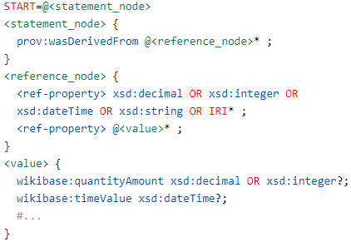
Dimension: Accuracy
Syntactic validity of reference triples
Statement node IDs
Pass -> full score 1
ShEx validator like shex.js / PyShEx
Fail -> 1-(no. fails/total)
Wikidata RDF model of references Shape

Slide 6
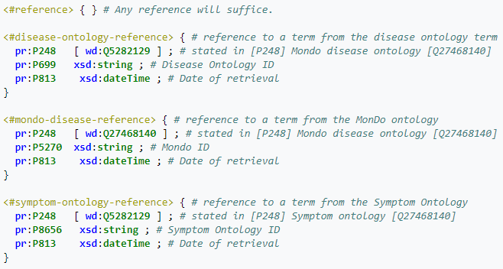
Dimension: Completeness
Schema completeness of references
How many classes and properties have a defined Entity Schemas (Eids) for references?

Slide 7
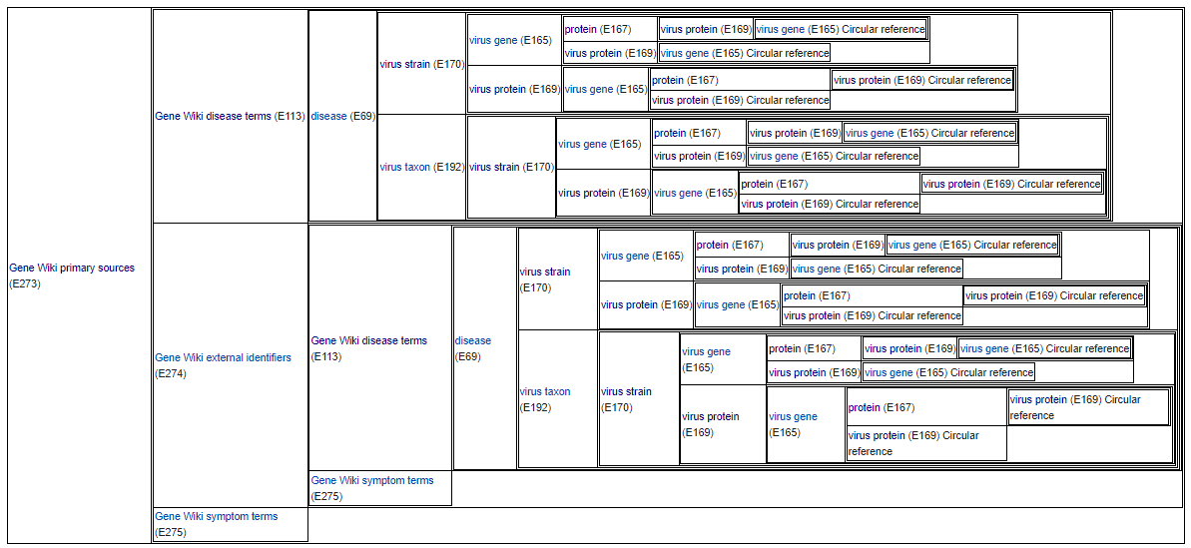
Dimension: Completeness
Schema completeness of references
https://www.wikidata.org/wiki/Wikidata:Database_reports/EntitySchema_directory

Slide 8
Dimension: Completeness
Schema-based property completeness of references
If a reference schema is defined for class/fact of type X, how many instances of X have got a reference with the property mentioned in the schema?
How many disease has got reference using P248/P699/P813
=>
How many symptoms has got reference using P248/P8656/P813
…
https://www.wikidata.org/wiki/EntitySchema:E273

Slide 9
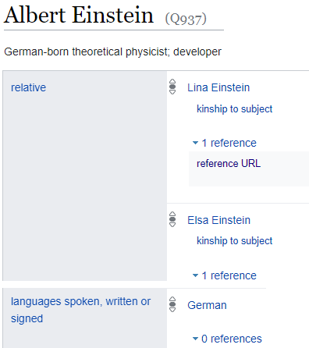
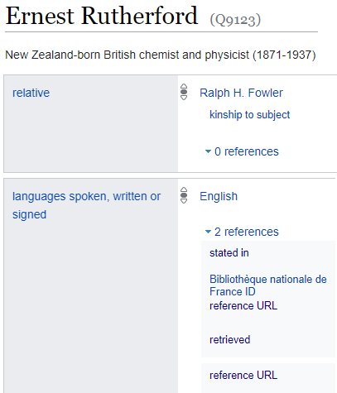
Dimension: Completeness
Property completeness of references
If a fact of type X has a reference using the ref-property Y, how many other type X facts have a reference using property Y?
X
X
no Y!
Y
Y
no Y!

Slide 10
Subsetting KGs
Timed-Out Queries
Huge Size of KGs
Reproducible Experiments
Wikidata 2021
100 GB
Reducing the Overall Costs

Slide 11
Topical subsets

Slide 12
Subsetting TOOLS
Configuration phase (Filtering): Defining the subset
Which Items should be extracted?
Which statements?
Which metadata (references, qualifiers, labels, …)?
Filtering item-based or fact-based?
Flexibility
Extraction phase: Cutting the defined subset from the main KG
Be as fast as possible
Extract accurately (be sure that the output has got what it should got)

Slide 13
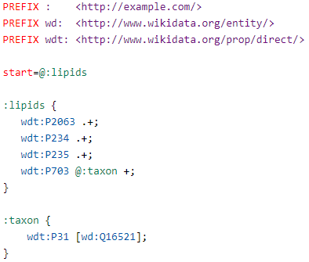
Defining subset via shex
A Simple Lipids subset
https://github.com/seyedahbr/biohackathon2021/tree/main/use_cases/lipidmaps

Slide 14
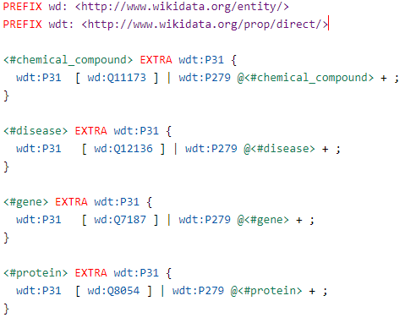
Defining subset via shex
Part of GeneWiki subset definition with considering sub-classes using recursive
https://github.com/seyedahbr/Wikidata_Reference_Statistics/blob/main/ShEx%20schemata/genewiki.shex

Slide 15
References
[1] A. Zaveri, A. Rula, A. Maurino, R. Pietrobon, J. Lehmann, S. Auer, Quality Assessment For Linked Data: A Survey, Semantic Web. 7 (2016) 63–93.
[2] Beghaeiraveri, S. A. H., Gray, A. J., & Mcneill, F. J. (2021, October). Reference Statistics In Wikidata Topical Subsets. In 2nd Wikidata Workshop.

